Slide 1

Big Data in Image Processing
Instructor: Hema Seshadri

Slide 2
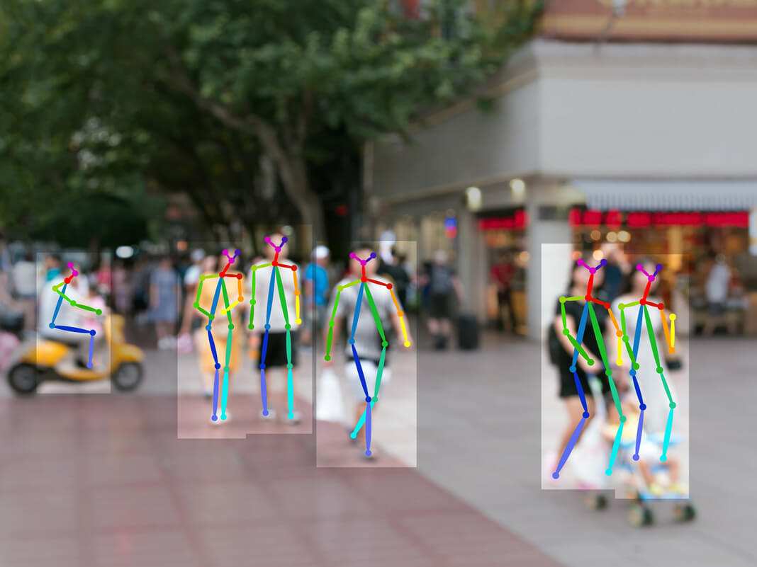
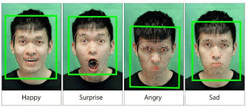
What is Image Processing
Image processing is any form of signal processing for which our input is an image, such as a photograph or a frame of video and our output can be either an Image or a set of characteristics or parameters related to the image.
Image 1 – emotion recognition
Image 2 – Body Structure recognition

Slide 3

How it works!
Big data with large amounts of information, like a massive collection of images, from various sources.
Since there are so many images, they need to be stored in super computers that can handle big data. These systems store the images in a way that allows for quick access and processing.
Once the images are stored, algorithms are used to process them. This means performing tasks like improving image quality, detecting objects in images, or finding similarities between different images.
With image processing in big data analytics, we can look for patterns or trends across thousands or even millions of images.
In big data analytics, we can use machine learning techniques. It's like teaching computers to recognize and understand images on their own. For example, we can train a computer to recognize cats in pictures by showing it many cat images until it learns what cats look like.

Slide 4
Convolutional Neural Networks (CNNs)
Input: Multi-dimensional array representing an image or a collection of images.
Output: Prediction or analysis result relevant to the task, such as class probabilities.
Images are typically represented as matrices or tensors, where each element of the matrix corresponds to a pixel value. For grayscale images, the matrix is two-dimensional, with each element representing the intensity of the pixel. For color images, the matrix is three-dimensional, with each element representing the intensity of a specific color channel (e.g., red, green, and blue).
Therefore, a "multi-dimensional array representing an image or a collection of images" refers to the numerical data structure that holds the pixel values of one or more images.
The output of a Convolutional Neural Network (CNN) refers to the information or results generated by the network based on the input image(s) and the specific task it is designed for.
For image classification, the output could be class probabilities, which are the likelihoods assigned to different categories or labels. For example, if the CNN is trained to classify images of animals, the output might include the probabilities of the input image being a cat, dog, or bird.

Slide 5
Popular Algorithms
Convolutional Neural Networks (CNNs)
Long Short Term Memory Networks (LSTMs)
Recurrent Neural Networks (RNNs)
Generative Adversarial Networks (GANs)
Radial Basis Function Networks (RBFNs)
Multilayer Perceptrons (MLPs)
Self Organizing Maps (SOMs)
Deep Belief Networks (DBNs)
Restricted Boltzmann Machines( RBMs)
Autoencoders

Slide 6
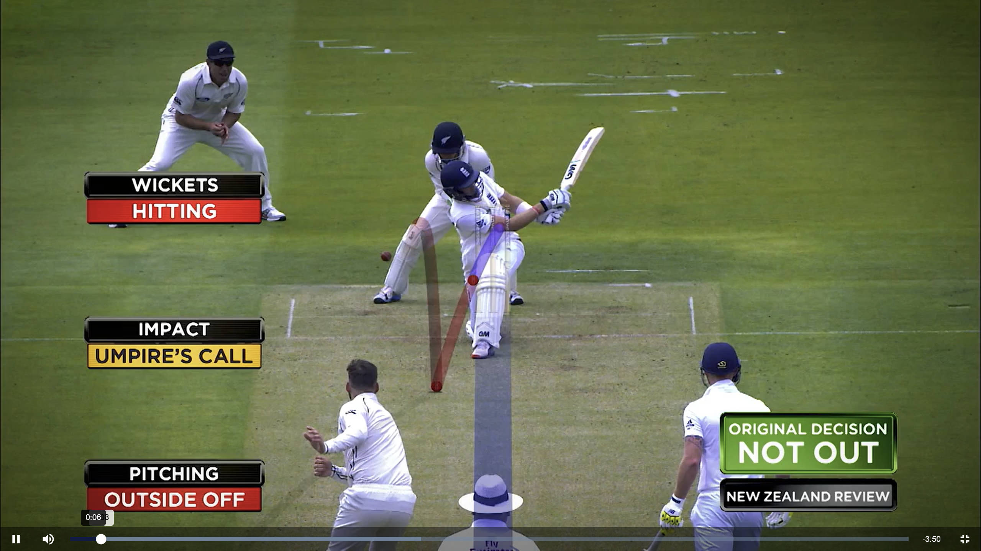
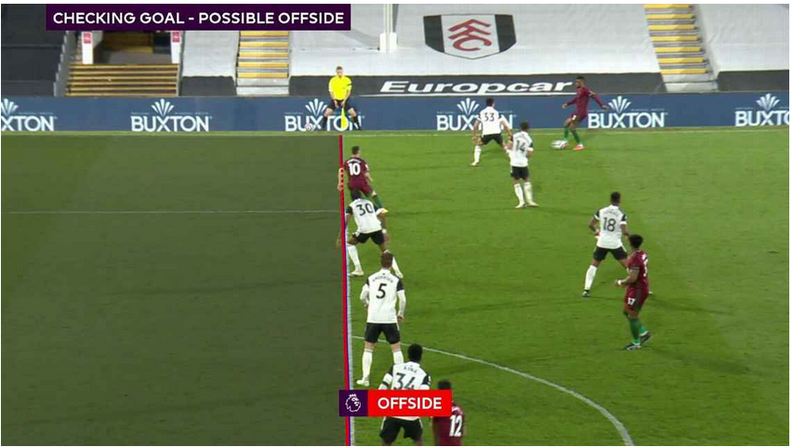
Image Processing in Sports
Leg Before Wicket (LBW) check
Off-side check

Slide 7
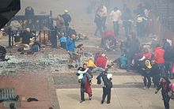
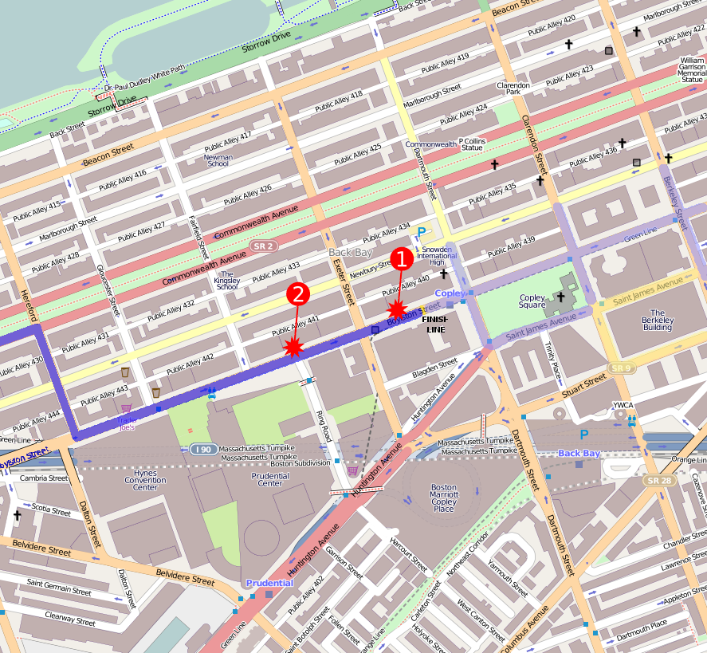
Why Image Processing matters
Figure 1. Boston Marathon explosions from Wikipedia
Figure 2. Boston Marathon bombings map from Wikipedia

Slide 8
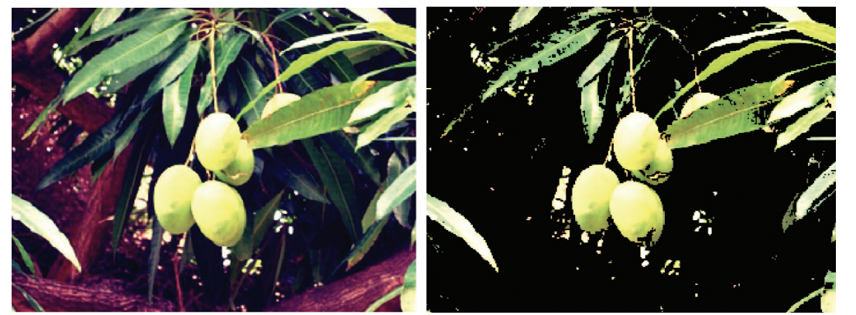
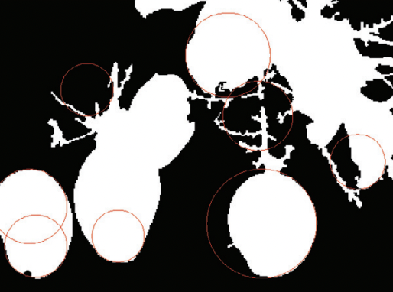
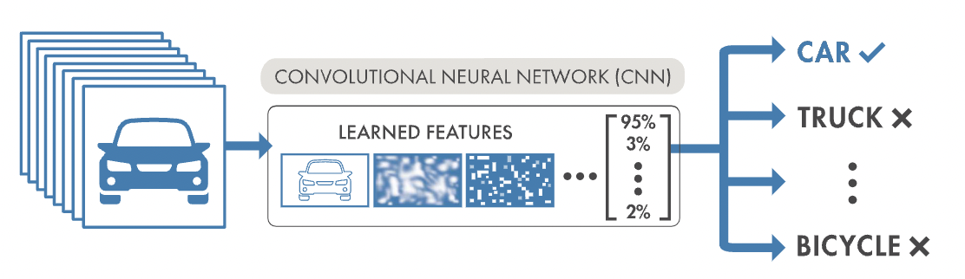
How Image Processing works
Data Preprocessing: resizing, normalization, denoising, filtering
Object Detection: Convolutional neural networks (CNNs).
Training a CNN model on a large labeled dataset, where images are annotated with bounding boxes around objects of interest.
Model learns to recognize patterns.
Model classifies each object into predefined classes.
Pattern recognition: identify patterns or anomalies
Template matching: predefined template image is compared to different regions of an input image
Feature extraction: extract relevant features that represent patterns or objects
Machine Learning: train models to automatically classify objects in new images based on learned patterns.
Figure 3. Result of Filtering from ScienceDirect
Figure 4. Object detection from ScienceDirect
Figure 5. CNN workflow from ScienceDirect

Slide 9
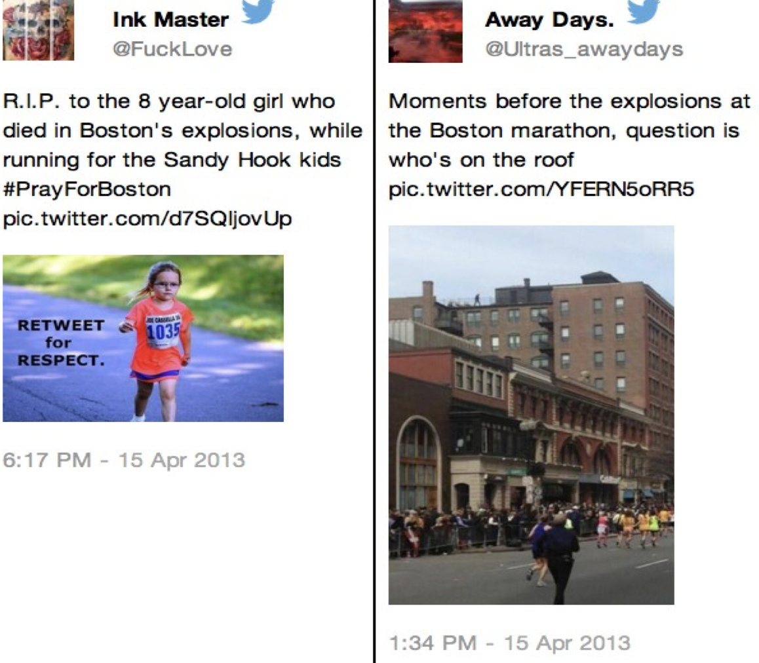
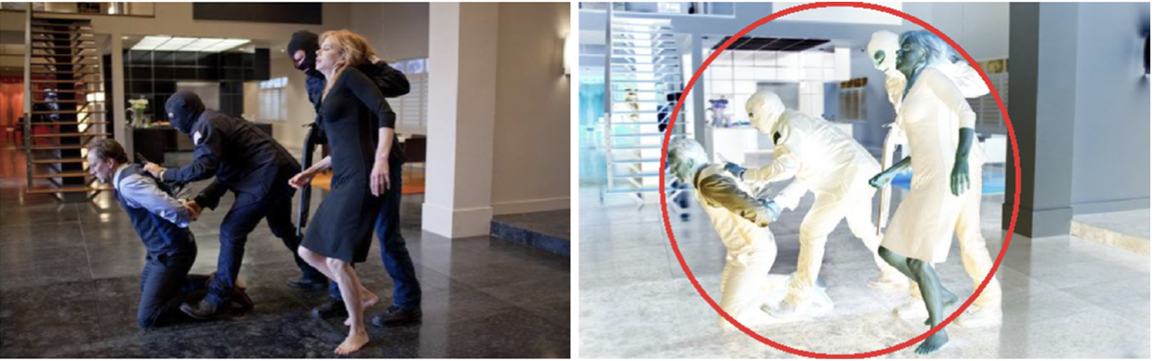
Image Processing with Big data
Images contain a wealth of information that can complement other data sources in big data analytics.
Combine cloud computing image processing technology can identify realtime crime behavior.
Figure 7. Patterns in Crime detection from Journal of Surveillance
Figure 6. Twitters after Boston Marathon Explosion from Wikipedia

Slide 10
References
Boston Marathon bombing. (2023, June 8). https://en.wikipedia.org/wiki/Boston_Marathon_bombing
How big data is helping in the Boston Marathon Bombing Investigation. (2021, September 28). https://senseient.com/ride-the-lightning/how-big-data-is-helping-in-the-boston-marathon-bombing-investigation/
Hussin, R. (2012, August 25). Digital image processing techniques for object detection from complex background image. https://www.sciencedirect.com/science/article/pii/S1877705812025684

